Slide 1
Section 9+10
Multiclass classification & MNIST

Slide 2
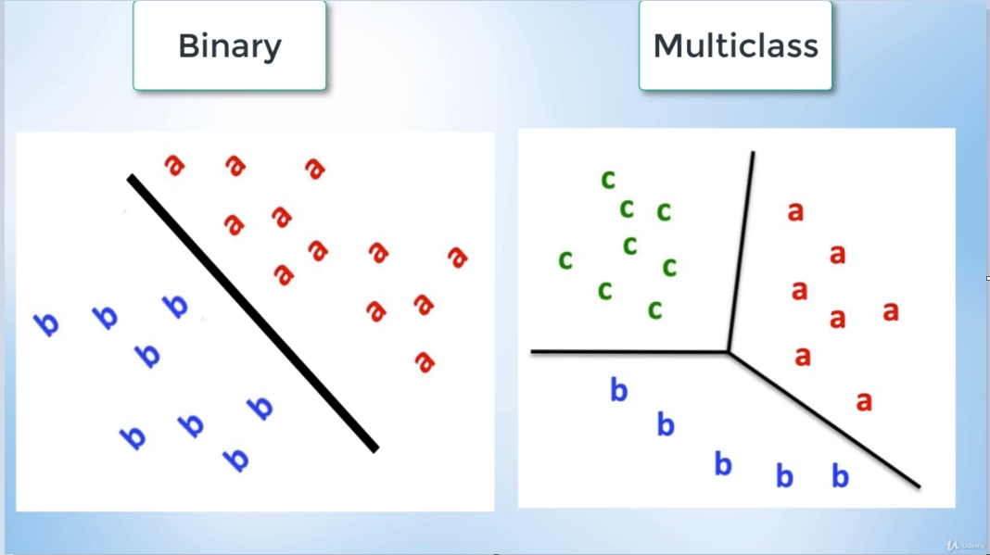
Section 9, Multiclass classification
Classify data in many classes

Slide 3

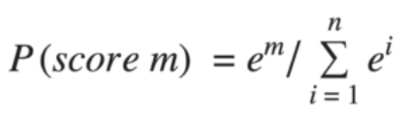
Softmax activation function
For binary classification we used sigmoid:
We need an activation function where the:
Relative magnitudes are maintained
All probabilities add up to 1
For multiple classes we use softmax activation function.

Slide 4
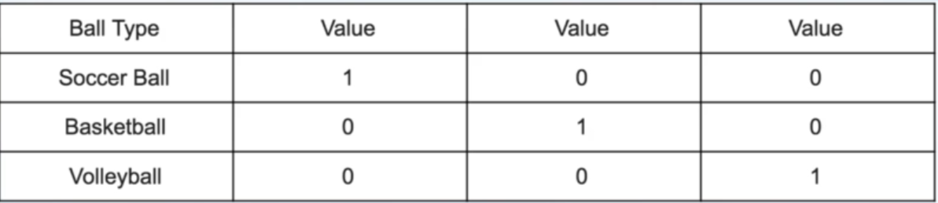
One-hot encoding
Categorical data is either nominal or ordinal
Ordinal data has a ranked order for its possible values, such as grades F-A, which can be meaningfully ranked as 1-6.
Nominal data has no quantitative relationship between the different values, such as football, basketball and volleyball. If these were converted to numerical values our model might pick up on a relationship that does not exist.
Fixed with One-hot encoding!

Slide 5
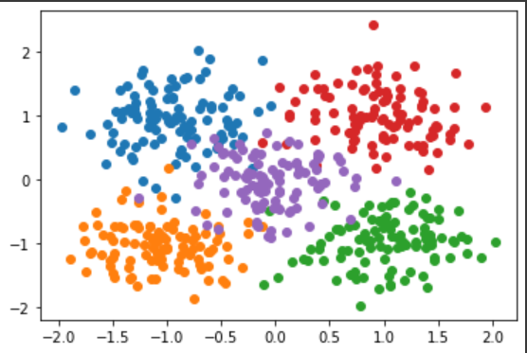
Data to classify

Slide 6
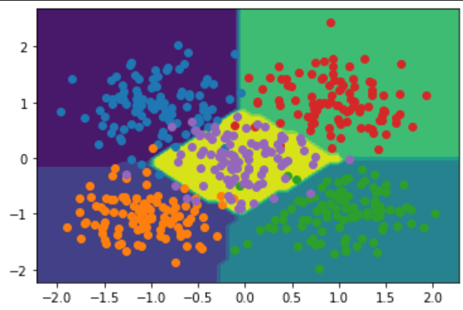
Results
Used one-hot encoding on the labels and a simple neural network with softmax activation function

Slide 7
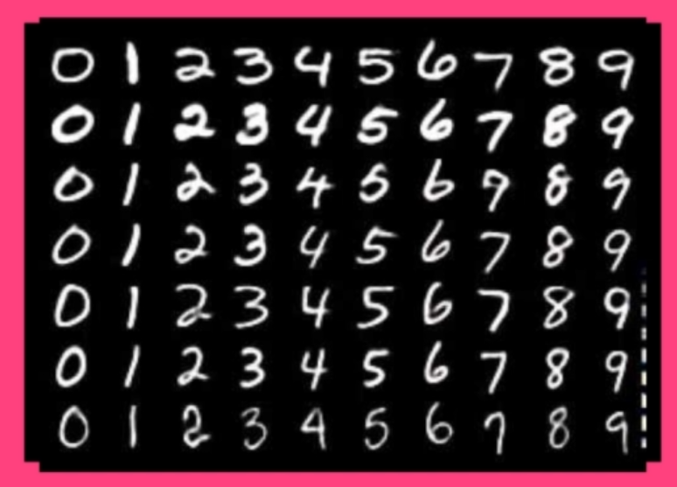
Section 10, MNIST Image Recognition
10 classes
28x28 pixel images
We will use a neural network with input layer that has 28x28=784 nodes
Data is split in train/validation/test

Slide 8
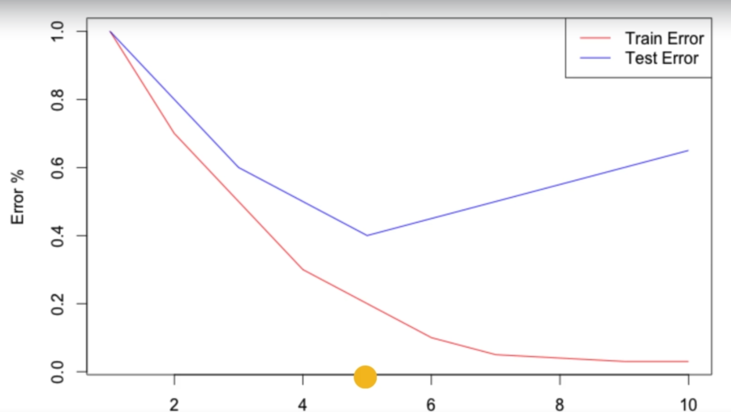
Generalization
We want our model to work on data that it has never seen before, i.e. we want our model to be generalizable
Training on train data reduces training error, we also want to minimize test error

Slide 9
Overfitting and underfitting
Underfitting
Model is not capable of understanding the data
Model is not advanced enough
Model can not accurately fit the data
Overfitting
Can be noted when the train error is very low and the testing error is high
Model memorizes very specific things, small details, instead of understanding generally
Can be fixed by reducing the capacity of the model

Slide 10
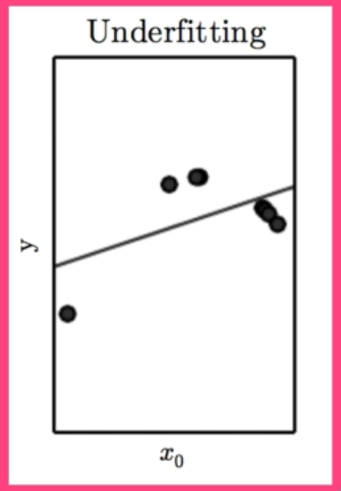
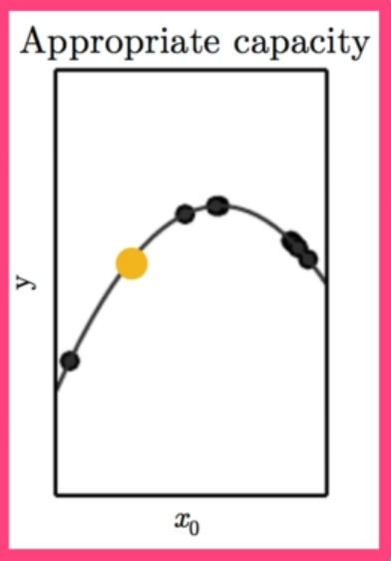
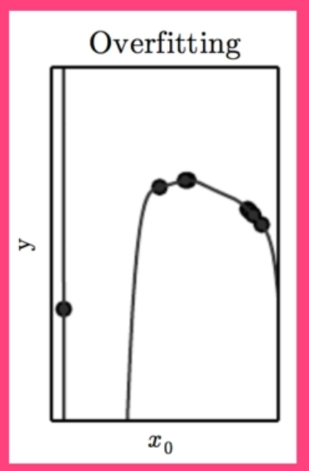
Overfitting and underfitting

Slide 11
Hyperparameters
Model parameters are learned by the model (weights and biases)
Hyperparameters are used to control the behaviour of the training algorithm
Tuning hyperparameters lets us configure the complexity of model
Examples of hyperparameters
Learning rate
Number of nodes per layer
Number of hidden layers
Depth
Training dataset is used to learn the model parameters, validation dataset is used to fine-tune hyperparameters

Slide 12
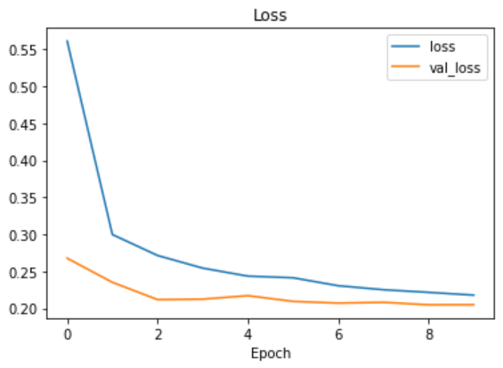
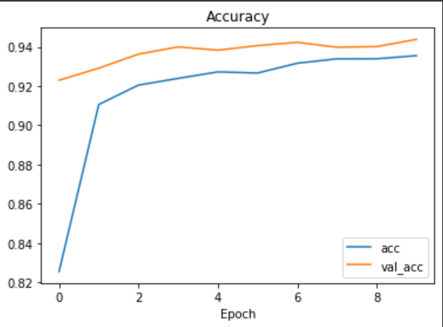
Results on MNIST
We use a simple dense neural network

Slide 13
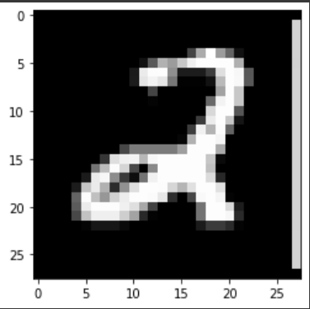
Results on MNIST
Test input. Our model predicts a 2.
However, our simple model on these simple images still require very many parameters and much training. We need a new type of network for images, next section we start on Convolutional Neural Networks.

